Slide 1
Chapter 11: Big Data and Analytics
Modern Database Management
12th Edition
Jeff Hoffer, Ramesh Venkataraman,
Heikki Topi

Slide 2
Objectives
Define terms
Describe why database management extends beyond relational DBs and DWs
List the main NoSQL DBMS categories
Choose between relational and NoSQL databases
Describe meanings and demands of big data
List and describe components of Hadoop environment
Compare descriptive, predictive, and prescriptive analytics
Describe impact of analytics on data management technologies

Slide 3
Introduction
Big Data
Data that exist in very large volumes and many different varieties (data types) and that need to be processed at a very high velocity (speed).
Analytics
Systematic analysis and interpretation of data—typically using mathematical, statistical, and computational tools—to improve our understanding of a real-world domain.
Notes:
This chapter is primarily about these two new advances in data technologies and approaches.
Traditional data management technologies were created to ensure accurate and efficient transaction processing. As we saw from chapter 9, later database structures were created to support decision-making and overall understanding of the business. We called these data warehouses. Big data and analytics takes us further down this road.

Slide 4
Characteristics of Big Data
The Five Vs of Big Data
Volume – much larger quantity of data than typical for relational databases
Variety – lots of different data types and formats
Velocity – data comes at very fast rate (e.g. mobile sensors, web click stream)
Veracity – traditional data quality methods don’t apply; how to judge the data’s accuracy and relevance?
Value – big data is valuable to the bottom line, and for fostering good organizational actions and decisions

Slide 5
Characteristics of Big Data
Schema on Read, rather than Schema on Write
Schema on Write– preexisting data model, how traditional databases are designed (relational databases)
Schema on Read – data model determined later, depends on how you want to use it (XML, JSON)
Capture and store the data, and worry about how you want to use it later
Data Lake
A large integrated repository for internal and external data that does not follow a predefined schema
Capture everything, dive in anywhere, flexible access
Notes:
Big data processing is done in batch mode, and may take hours to sift through the huge volume of data for an analytical task.
Big Data processing via Hadoop is good for long analytical tasks but not so good for exploring individual cases and their relationships. For this, relational databases and data warehouses are better.

Slide 6
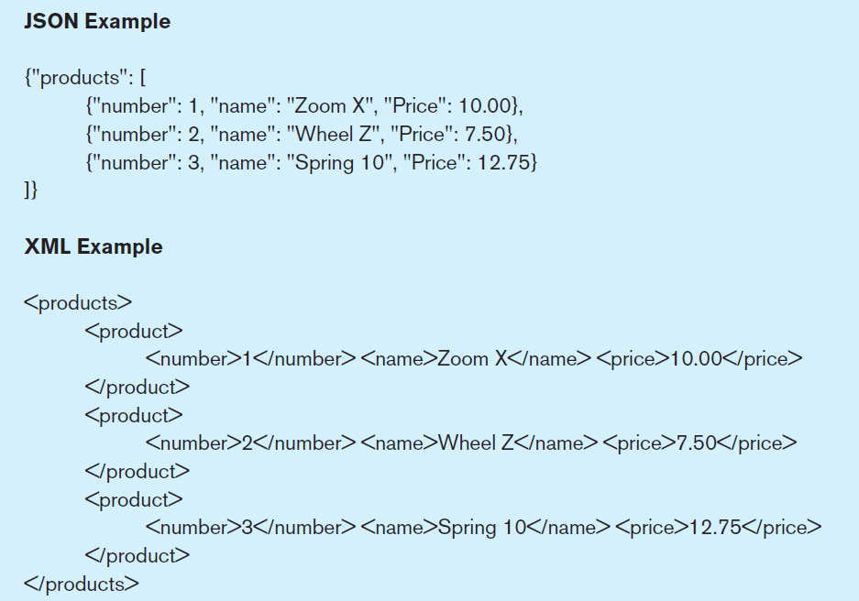
Figure 11-1 Examples of JSON and XML
JavaScript Object Notation
eXtensible Markup Language
Notes:
Both JSON and XML provide a semi-structured means of representing data hierarchically. JSON is also a major component of the JavaScript language. We talked a lot about XML in chapter 8.

Slide 7
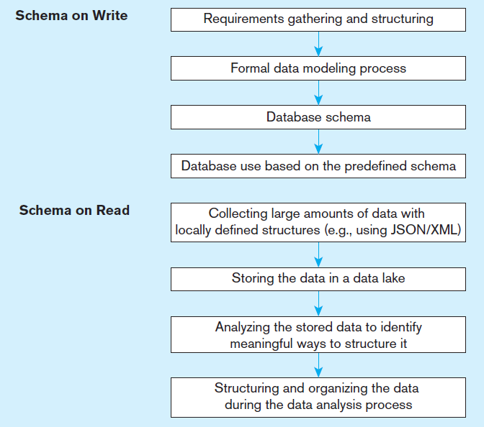
Figure 11-2 Schema on write vs. schema on read
Traditional database design
The big data approach
Notes:
Collect and store everything into the data lake. Worry about what you’re going to do with it later. That’s the big data approach. There are lots of ways to structure data and you can do it after the fact, as long as the data obeys certain data standards (like XML or JSON).

Slide 8
NoSQL
NoSQL = Not Only SQL
A category of recently introduced data storage and retrieval technologies not based on the relational model
Scaling out rather than scaling up
Natural for a cloud environment
Supports schema on read
Largely open source
Not ACID compliant!
BASE – basically available, soft state, eventually consistent

Slide 9
NoSQL Classifications
Key-value stores
A simple pair of a key and an associated collection of values. Key is usually a string. Database has no knowledge of the structure or meaning of the values.
Document stores
Like a key-value store, but “document” goes further than “value”. Document is structured so specific elements can be manipulated separately.
Wide-column stores
Rows and columns. Distribution of data based on both key values (records) and columns, using “column groups/families”
Graph-oriented database
Maintain information regarding the relationships between data items. Nodes with properties, Connections between nodes (relationships) can also have properties.

Slide 10
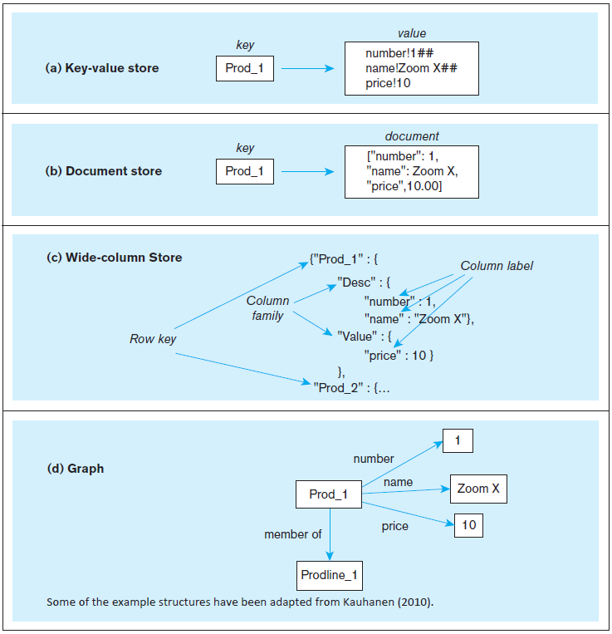
Figure 11-3 Four-part figure illustrating NoSQL databases
Notes:
As you can see, these are very different from relational databases. But you still have the notion of a unique entity, identified by its key, and the notion that this entity has attributes. Also remember from chapter 5 that key-value storage is nothing new. Remember hashed file organizations?

Slide 11
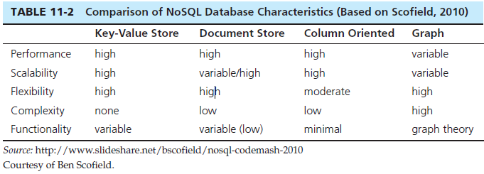
NoSQL Comparison
NoSQL Examples
Redis – Key-value store DBMS
MongoDB – document store DBMS
Apache Cassandra – wide-column store DBMS
Neo4j – graph DBMS
Notes:
NoSQL brings an exciting new dimension to the database profession.
Note that “NoSQL” does not mean “No SQL”. It means “Not Only SQL”. SQL will be a part of database systems for some time to come.

Slide 12
Hadoop
Hadoop is an open source implementation framework of MapReduce
MapReduce is an algorithm for massive parallel processing of various types of computing tasks
Hadoop Distributed File System (HDFS) is a file system designed for managing a large number of potentially very large files in a highly distributed environment
Hadoop is the most talked about Big-Data data management product today
Hadoop is a good way to take a big problem and allow many computers to work on it simultaneously
Notes:
A key feature of big data is highly distributed processing. The internet allows you to do this, by sharing tasks across hundreds or thousands of computers. Hadoop is made up of MapReduce and HDFS.
Hadoop’s essence is in processing very large amounts (terabytes or petabytes) of data by distributing the data and processing tasks among a large number of low-cost commodity servers. That means plain old PCs and servers.

Slide 13
Hadoop Distributed File System (HDFS)
A file system, not a DBMS, not relational
Breaks data into blocks and distributes them on various computers (nodes) throughout a Hadoop cluster
Each cluster consists of a NameNode (master server) and some DataNodes (slaves)
Overall control through YARN (“yet another resource allocator”)
No updates to existing data in files, just appending to files
“Move computation to the data”, not vice versa

Slide 14
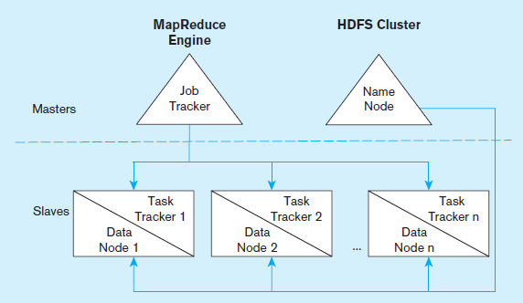
Figure 11-5 Four part figure illustrating NoSQL databases
Notes:
Hadoop is made up of the MapReduce engine and HDFS clusters. We’ll talk about each of these next. Note that the MapReduce engine includes an overall job tracker to manage activity on the entire cluster in the master server, and task trackers for each slave of the cluster. Each slave is a data node, and the master is a name node.

Slide 15
MapReduce
Enables parallelization of data storage and computational problem solving in an environment consisting of a large number of commodity servers
Programmers don’t have to be experts at parallel processing
Core idea – divide a computing task so that a multiple nodes can work on it at the same time
Each node works on local data doing local processing.
Two stages:
Map stage – divide for local processing
Reduce stage – integrate the results of the individual map processes
Notes:
Parallel programming has existed before MapReduce, but it is very complicated. MapReduce purports to simplify this a lot.

Slide 16
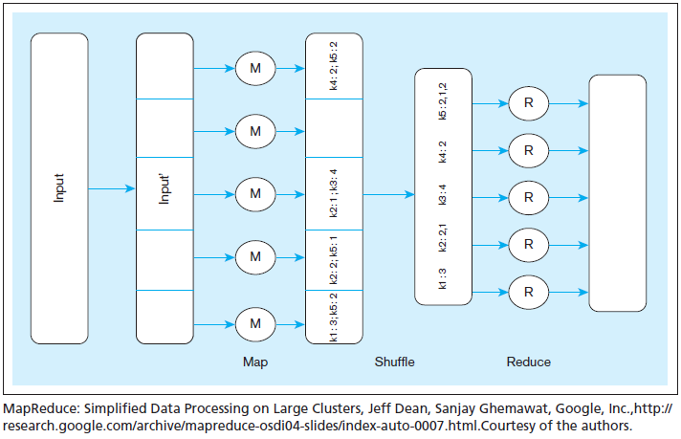
Figure 11-6 Schematic representation of MapReduce
Notes:
In this example, the form of this data is in key-value pairs. So, the keys in the figure are k1, k2, etc. Assume that the problem is to get an overall count of how many times the key appears in the data. For example, consider that the keys are customer IDs and the values are individual orders for each customer. So, we’re trying to figure out how many orders each customer made. Also assume that the original input data is very, very, very large. In other words, bigger than what a single relational DBMS can handle.
The original input data is received at the master and then divided into subsets, each of which goes to an individual slave node. So, each slave node gets some number of sales orders. This is the map process. There may be hundreds of these nodes.
Each node works on its subset of the data. Its task is to find out how many orders for each customer. So for example, the node at the bottom found 3 k1 orders and 2 k5 orders. Note that multiple nodes may have found examples of the same key. For instance, k2 is found in two of the nodes.
The shuffle step is at the end of mapping, and merges all the map outputs and packages them for the reduce phase. At this point, we’ve collected all results and grouped them by key value.
The reduce stage integrates the results of each of the map processes, creating the final result
It is up to the developer to define the mapper and the reducer so that they together get the work done. So, MapReduce programming involves writing code to do the mapping and writing code to do the reducing.

Slide 17
Other Hadoop Components
Pig
A tool that integrates a scripting language and an execution environment intended to simplify the use of MapReduce
Useful development tool
Hive
An Apache project that supports the management and querying of large data sets using HiveQL, an SQL-like language that provides a declarative interface for managing data stored in Hadoop.
Useful for ETL tasks
HBase
A wide-column store database that runs on top of HDFS
Not as popular as Cassandra
Notes:
Pig and Hive help to make Hadoop more accessible to traditional developers.

Slide 18
Integrated Analytics and Data Science Platforms
Some vendors are bringing together traditional data warehousing and big data capabilities
Examples
HP HSAVEn – Hewlett Packard technologies combined with Hadoop open source and an analytics engine
Teradata Aster – integrate SQL, graph analysis, MapReduce, R
IBM Big Data Platform – combine IBM technologies with Hadoop, JSON Query Language (JAQL),DB2, Netezza

Slide 19
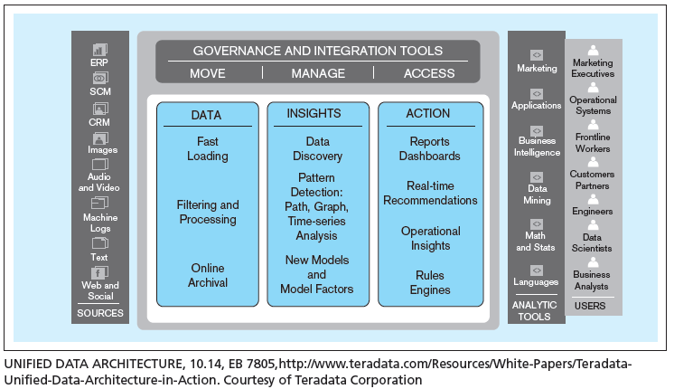
Integrated Data Architecture
Figure 11-8 Teradata Unified Data Architecture – logical view
Notes:
This is Teradata’s model of how various elements of a modern data management environment belong together. Here we see a logical view. Data sources are at one end and users at another. In between are three core activities: data, insights, and actions.

Slide 20
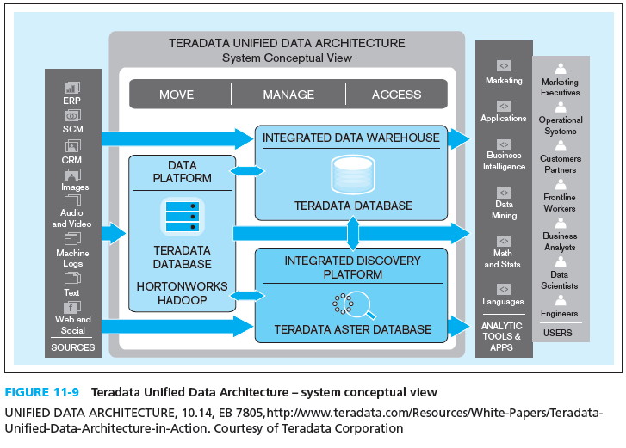
Integrated Data Architecture
Figure 11-9 Teradata Unified Data Architecture – system conceptual view
Notes:
Here we see the system conceptual view. Notice the intersection of Teradata’s proprietary database engine with Hadoop, and the use of Aster for discovery. The Data Platform allows for capturing data from the sources and prepare and store it for analytical purposes.

Slide 21
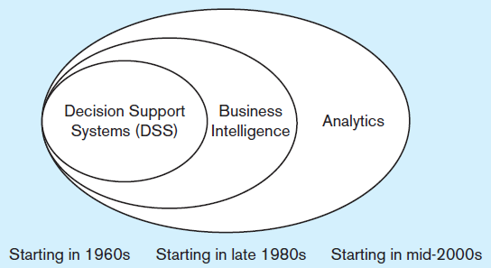
Analytics
Historical precedents to analytics:
Management information systems (MIS) ➔ Decision Support Systems (DSS) ➔ Executive Information Systems (EIS)
DSS idea evolved into Business Intelligence (BI)
Business Intelligence – a set of methodologies, processes, architectures, and technologies that transform raw data into meaningful and useful information.
Analytics encompasses more than BI
Umbrella term that includes BI
Transform data to useful form
Infrastructure for analysis
Data cleanup processes
User interfaces
Notes:
The IT field is full of jargon and buzzwords whose names change over time. In one book or article, you may read that BI is an umbrella term and includes analytics as a component. Others describe them in exactly the opposite relationship. And some say that BI and analytics are exactly the same thing.

Slide 22
Types of Analytics
Descriptive analytics – describes the past status of the domain of interest using a variety of tools through techniques such as reporting, data visualization, dashboards, and scorecards
Predictive analytics – applies statistical and computational methods and models to data regarding past and current events to predict what might happen in the future
Prescriptive analytics –uses results of predictive analytics along with optimization and simulation tools to recommend actions that will lead to a desired outcome
Notes:
With descriptive analytics we ask what happened already (last week, last year, etc.). With predictive analytics we ask what’s going to happen in the future and how will it affect us. With prescriptive analytics, we ask what is the best decision to make.

Slide 23
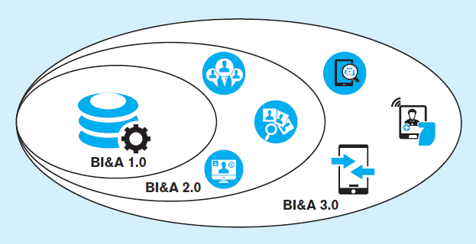
Figure 11-11 Generations of Business Intelligence and Analytics
Adapted from Chen et al., 2012
BI&A 1.0
Focus on structured quantitative data largely from relational databases
BI&A 2.0
Include data from the Web (web interaction logs, customer reviews, social media)
BI&A 2.0
Include data from mobile devices, (location, sensors, etc.) as well as Internet of Things
Notes:
BI&A has evolved along with other elements of information technology. It should be noted that there is far more unstructured and semistructured data (characteristic of Web and mobile technology) than there is structured data (typically found in relational databases). And although all data (structured and unstructured alike) is increasing in volume over time, the rate of growth is largest in the unstructured space.

Slide 24
Use of Descriptive Analytics
Descriptive analytics was the original emphasis of BI
Reporting of aggregate quantitative query results
Tabular or data visualization displays
Dashboard – a few key indicators
Scorecard – like a dashboard, but broader range
OLAP – online analytical processing

Slide 25
SQL OLAP Querying
SQL is generally not an analytic language, but it can be used for analysis.
However, OLAP extensions to SQL make this easier.
OLAP queries should support:
Categorization – e.g. group data by dimension characteristics
Aggregation – e.g. create averages per category
Ranking – e.g. find customer in some category with highest average monthly sales

Slide 26
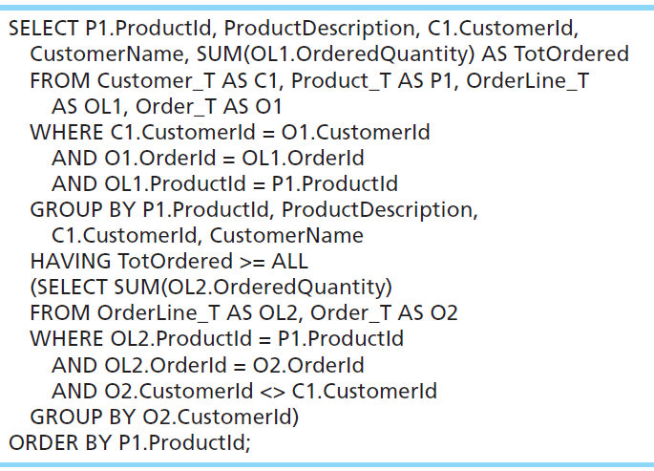
Regular SQL Query
TOP 1
Can be removed
Notes:
This query answers the question:
Which customer has bought the most of each product we sell? Show the product ID and description, customer ID and name, and the total quantity sold of that product to that customer; show the results in sequence by product ID.
This approach uses a correlated subquery to find the set of total quantity ordered across all customers for each product, and then the outer query selects the customer whose total is greater than or equal to all of these (in other words, equal to the maximum of the set).
A very labor-intensive and difficult query to write.
But the boxed-in part could be eliminated if you use the TOP 1 clause (which was discussed in chapter 7). TOP and BOTTOM are not standard SQL, but are supported by some relational DBMSs.

Slide 27
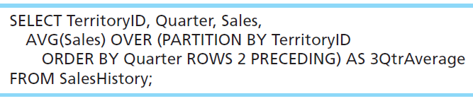
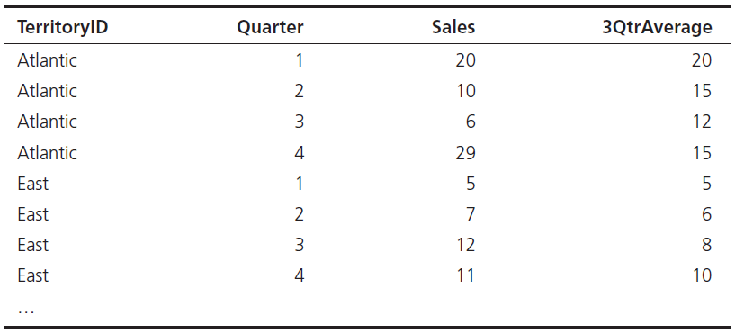
OLAP SQL Query
Consider a SalesHistory table (columns TerritoryID, Quarter, and Sales) and the desire to show a three-quarter moving average of sales.
OVER (also called WINDOW) is a special clause that provide a “sliding view” of rows from a query. PARTITION BY is like a GROUP by for OVER.
Notes:
This query includes several special OLAP clauses and does a complex operation with considerable simplicity compared to standard SQL.
Other special OLAP SQL clauses include QUALIFY, RANK, DENSE_RANK, CUME_DIST, and SAMPLE.

Slide 28
Online Analytical Processing (OLAP) Tools
Online Analytical Processing (OLAP) -- the use of a set of graphical tools that provides users with multidimensional views of their data and allows them to analyze the data using simple windowing techniques
Relational OLAP (ROLAP) – OLAP tools that view the database as a traditional relational database in either a star schema or other normalized or denormalized set of tables
Multidimensional OLAP (MOLAP) –OLAP tools that load data into an intermediate structure, usually a three- or higher-dimensional array.
Notes:
OLAP is often (but not always) associated with multidimensional database structures, otherwise known as cubes. The next slide shows a figure of a cube.

Slide 29
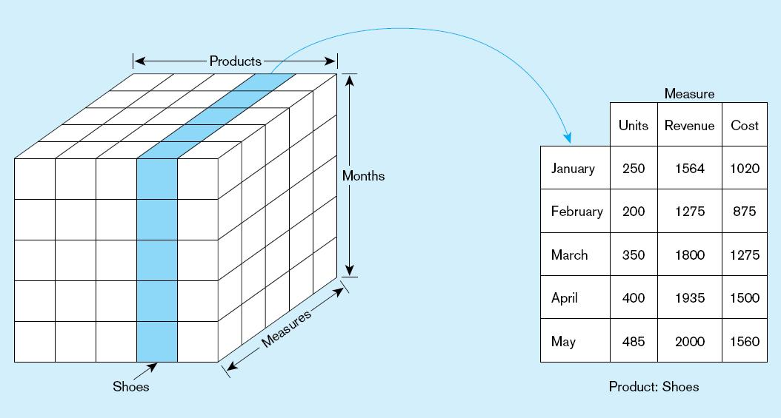
Figure 11-12 Slicing a data cube
Slicing, dicing, pivoting, and drill-down are useful cube operations
Notes:
This is a three dimensional cube Each cell in the cube pertains to a particular measure of a particular product of a particular month. When you slice a cube, you reduce the number of dimensions by focusing on one “slice” of a particular dimension. In this case, we focused on shoes. So, the two dimensional result is to see, for each month, the different measures (units, revenue, and cost).

Slide 30
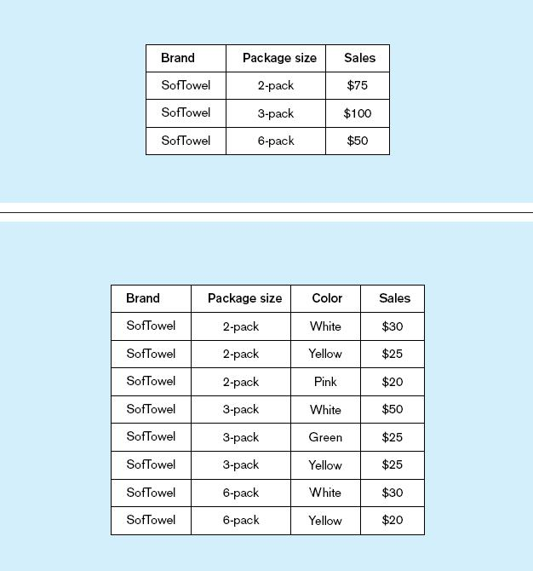
Summary report
Figure 11-13
Example of drill-down
Starting with summary data, users can obtain details for particular cells.
Drill-down with color added
Notes:
The term drill-down refers to going from higher levels of aggregation (summary information) to more detail. You could also call it “disaggregation”.
Executing a drill-down (as in this example) may require that the OLAP tool “reach back” to the data warehouse (or even the operational data) to obtain the detail data necessary for the drill-down. Automating this type of operation in an OLAP tool requires an integrated set of metadata.

Slide 31
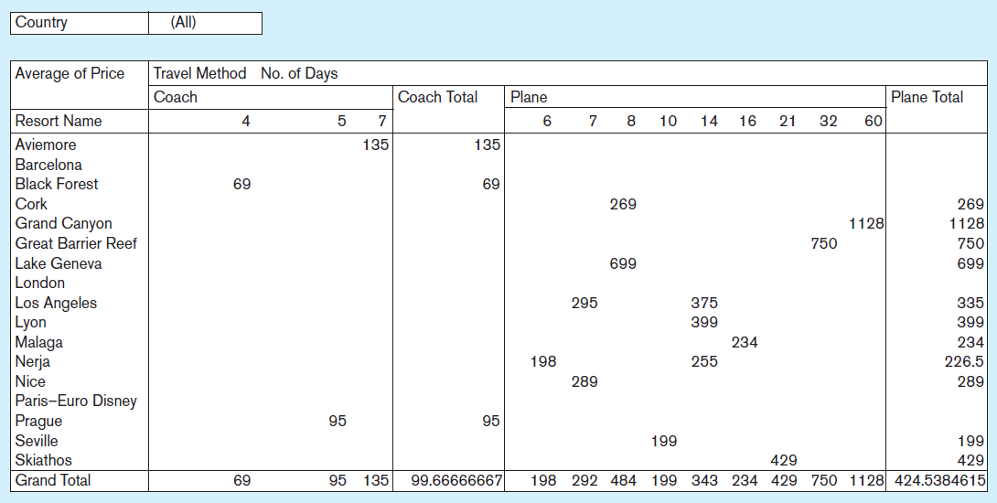
Figure 11-14 Sample pivot table with four dimensions:
Country (pages), Resort Name (rows), Travel Method, and No. of Days (columns)
Although the screen is only two dimensions, you can include more dimensions by combining multiple in a row or column, and by including paging
Notes:
This figure shows a schematic of what the user interface for a cube might look like. Often, the user interface is done in spreadsheet software like Excel.
Cubes can display as many dimensions as you want. And the user interface also supports pivoting. So, for example, it would be simple to switch the view such that resort name would appear in the columns and travel method in the row, or to bring countries into the columns and number of days into the pages..

Slide 32
Data Visualization
Representation of data in graphical and multimedia formats for human analysis
“A picture tells a thousand words”
Without showing precise values, graphs and charts can depict relationships in the data
Often used in dashboards, as shown in next slide

Slide 33
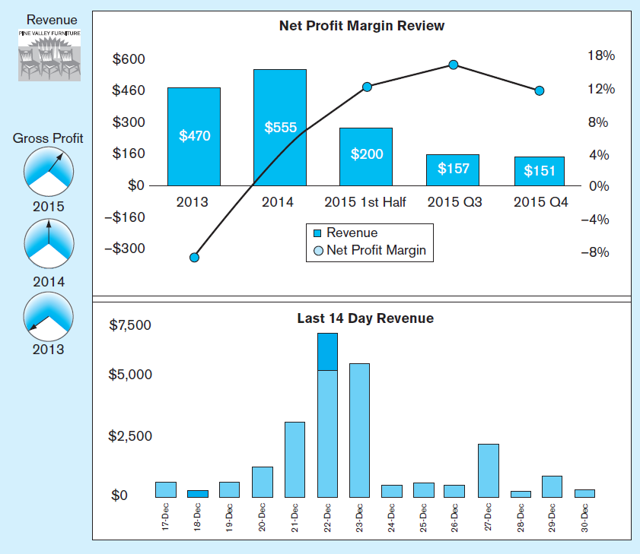
Business Performance Mgmt (BPM)
Figure 11-16
Sample Dashboard
BPM systems allow managers to measure,
monitor, and manage key activities and processes to achieve organizational goals.
Dashboards are often used to provide an information system in support of BPM.
Charts like these are examples of data visualization, the representation of data in graphical and multimedia formats for human analysis.

Slide 34
Predictive Analytics
Statistical and computational methods that use data regarding past and current events to form models regarding what might happen in the future
Examples: classification trees, linear and logistic regression analysis, machine learning, neural networks, time series analysis, Bayesian modeling
Notes:
Here are some examples of questions that might be answered through predictive analytics:
• What type of an offer will a specific prospective customer need so that she/he will become a new customer?
• What solicitation approaches are most likely to lead to new donations from the patrons of a non-profit organization?
• What approach will increase the probability of a telecommunications company succeeding in making a household switch to their services?
• What will prevent an existing customer of a mobile phone company from moving to another provider?
• How likely is a customer to lease their next automobile from the same company from which they leased their previous car?
• How profitable is a specific credit card customer likely to be during the next five years?

Slide 35
Data Mining Tools
Knowledge discovery using a sophisticated blend of techniques from traditional statistics, artificial intelligence, and computer graphics
Goals:
Explanatory – explain observed events or conditions
Confirmatory – confirm hypotheses
Exploratory –analyze data for new or unexpected relationships
Text mining – Discovering meaningful information algorithmically based on computational analysis of unstructured textual information
Notes:
Traditional data mining works with structured data, such as numerical and categorical data, that you would typically find in relational databases. But with the advent of the web and social media, there is a huge amount of unstructured data in the form of text entries in blogs, emails, and tweets. This is just as important as, and actually much higher in volume than, structured data. Wo text mining is an increasingly important part of data mining.

Slide 36
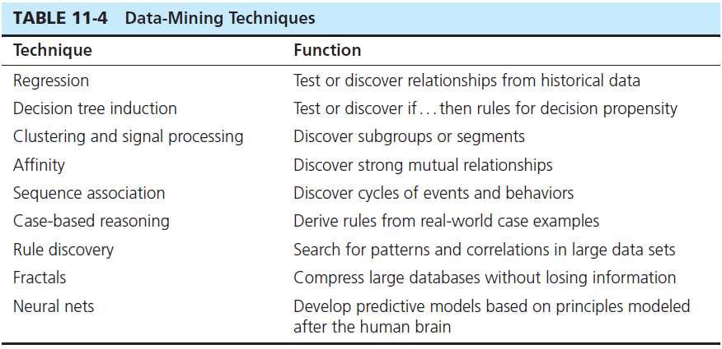
Notes:
These techniques are derived from computer science, artificial intelligence, and statistics.
The choice of an appropriate technique depends on the nature of the data to be analyzed, as well as the size of the data set.

Slide 37
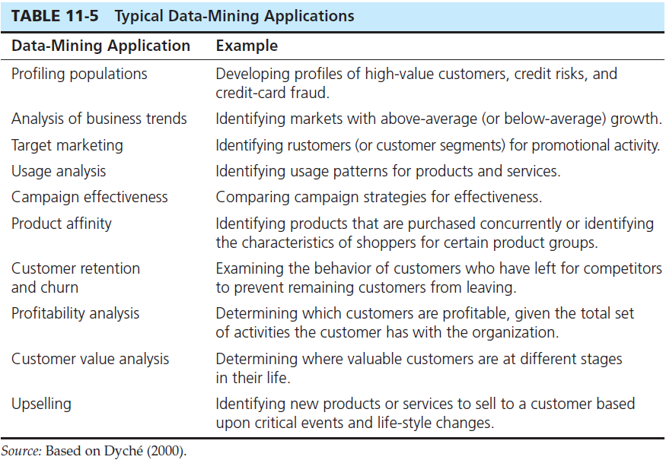
Notes:
Different data mining techniques are appropriate for different applications. For example, applications dealing with classification problems are typically done using regression or decision trees. This is useful for target marketing and population profiling. Product affinity and upselling is done via the affinity technique (also called association). The textbook describes a product called KNIME that used k-means, a clustering algorithm, for analyzing churn.

Slide 38
KNIME Example of Predictive Analytics
Credit scoring
Takes past financial data to produce a credit score
Starts with decision trees, neural networks, and support vector machine (SVM) algorithms for initial model
Next uses Predictive Modeling Markup Language (PMML)
Marketing
Churn analysis – predicting which customers will leave using clustering via k-means algorithm
Social media analysis using association rules
Notes:
KNIME is an open data mining platform. More information is found at https://www.knime.org/. KNIME stands for KoNstanz Information MinEr and is based in Zurich, Switzerland.
There are many open and proprietary data mining software products. One popular proprietary product is SAS Enterprise Miner.

Slide 39
Use of Prescriptive Analytics
Use of optimization and simulation tools for prescribing the best action to take
Example applications
Making trading decisions in securities and stock market
Making pricing decisions for airlines and hotels
Making product recommendations (e.g. Amazon and Netflix)
Often requires predictive analytics and game theory

Slide 40
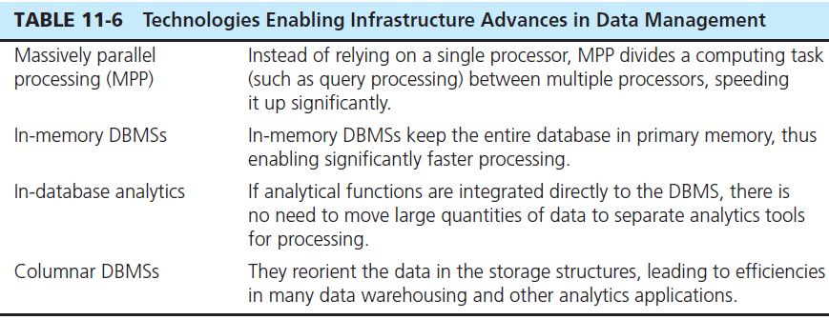
Analytics Data Management Infrastructure
Important criteria: scalability, parallelism, low latency, and data optimization
These criteria ensure speed, availability, and access

Slide 41
Big Data and Analytics Impact: Applications
Business
E-government and politics
Science and technology
Smart health and well-being
Security and public safety
Notes:
Big data and analytics have already significantly affected these areas of human activity. There is potential for much more significant transformation in these and other areas as time goes on.
Success in these areas require significant effort in collection, organizing, quality control, and analysis.

Slide 42
Big Data and Analytics Impact: Social Implications
Personal privacy vs. collective benefit
Ownership and access
Data/algorithm quality and reuse
Transparency and validation
Demands for workforce capabilities and education
Notes:
Big data analytics raises a number of important questions regarding possible negative implications.
This list of issues was identified in a 2014 workshop hosted by the U.S. National Science Foundation.

Slide 43


